Slide 1
Smart Water Management
Team # 7
Centralized water Management for a Smart City living
CodeWalkers - KGiSL

Slide 2
The Problem

Slide 3
Water Management

Slide 4
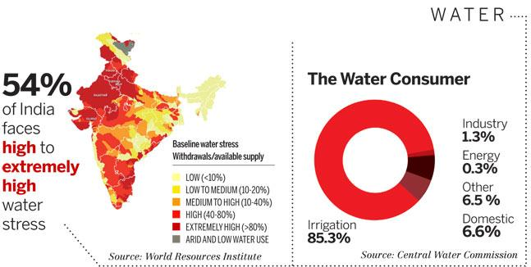

Slide 5
Common man’s Problem...

Slide 6
Problem ?
Drinking water scarcity in the city
Surprising water timings
Wastage of water
Managing water flow
Contaminated water

Slide 7
Our Solution...

Slide 8




IOT
Control Center
Control Station - Raspberry Pi
Sensors

Slide 9
Centralized control
Take control of the Entire System
Automate the water flow
Eliminate manual switching
Monitor the Flow and prevent wastage

Slide 10
Advantage to Common man
Water flow notification.
Adequate water supply
Clean water
Efficient water usage

Slide 11
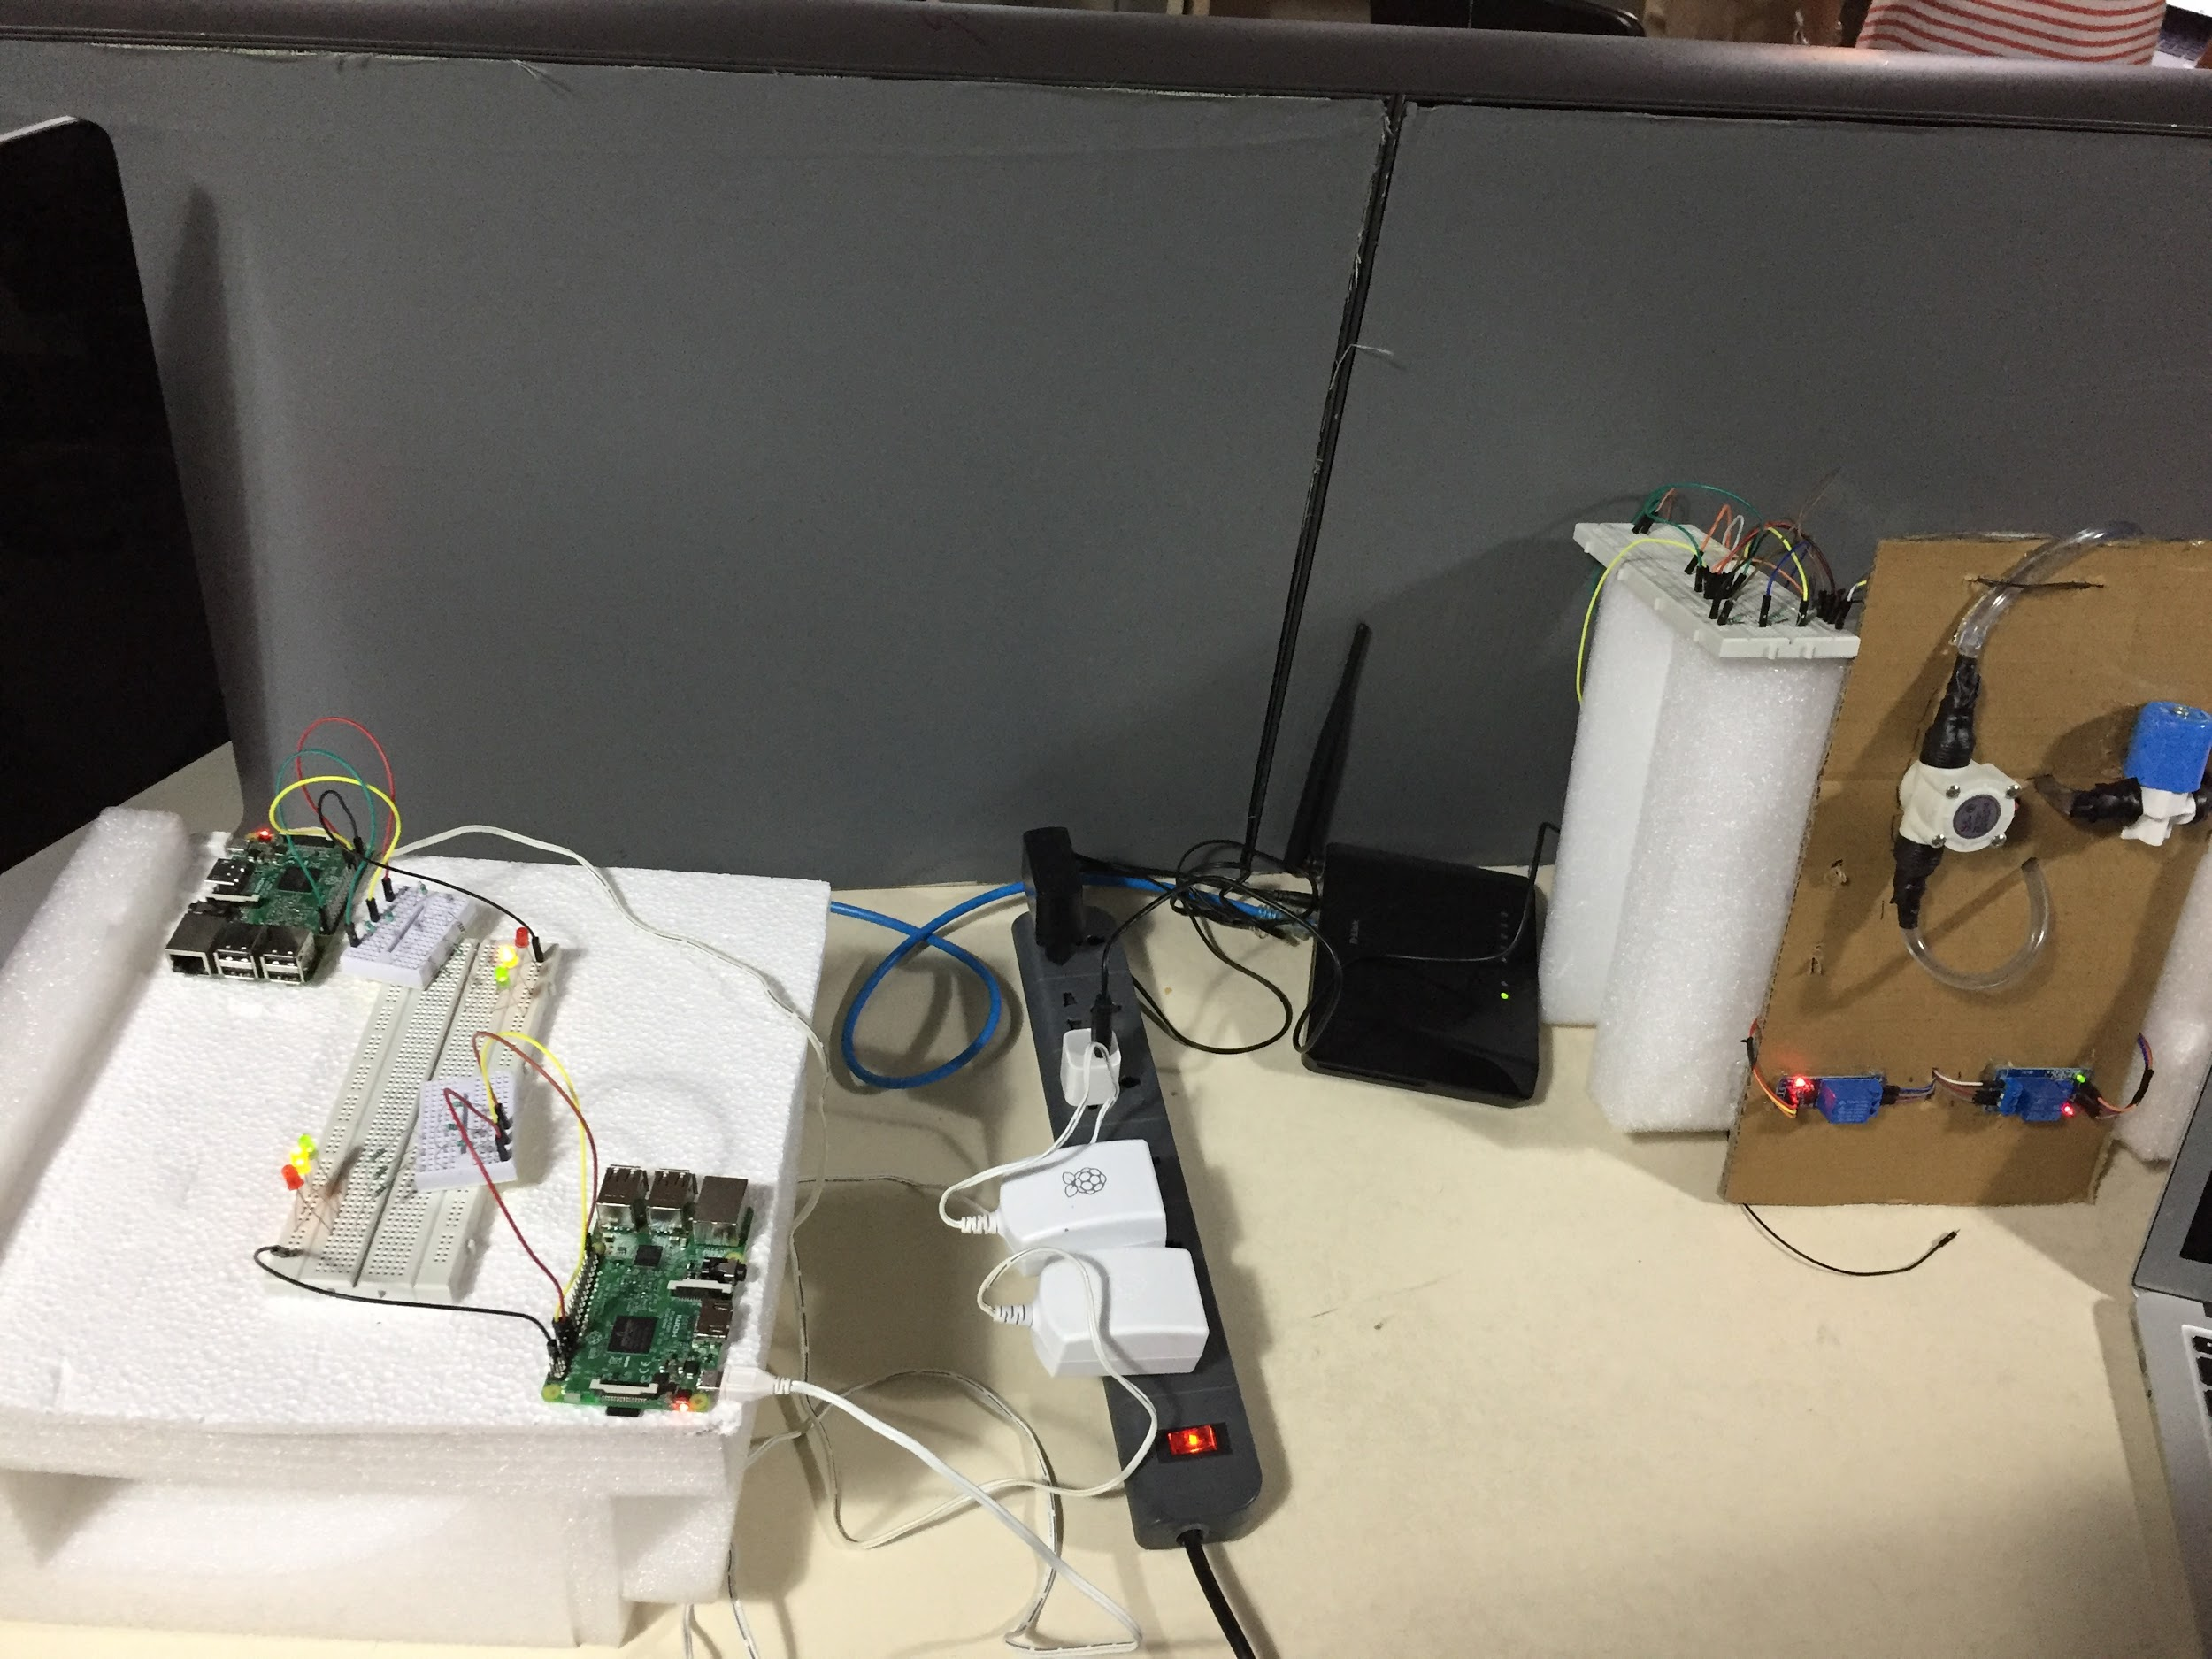

Slide 12
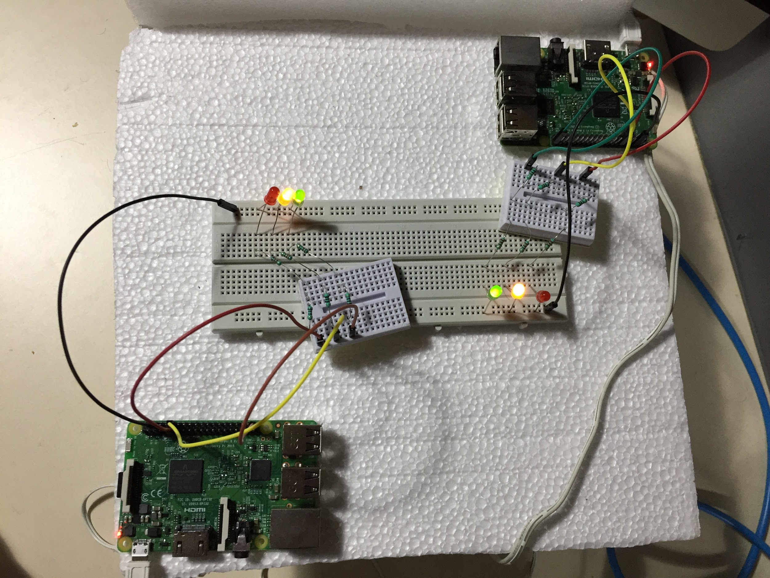

Slide 13
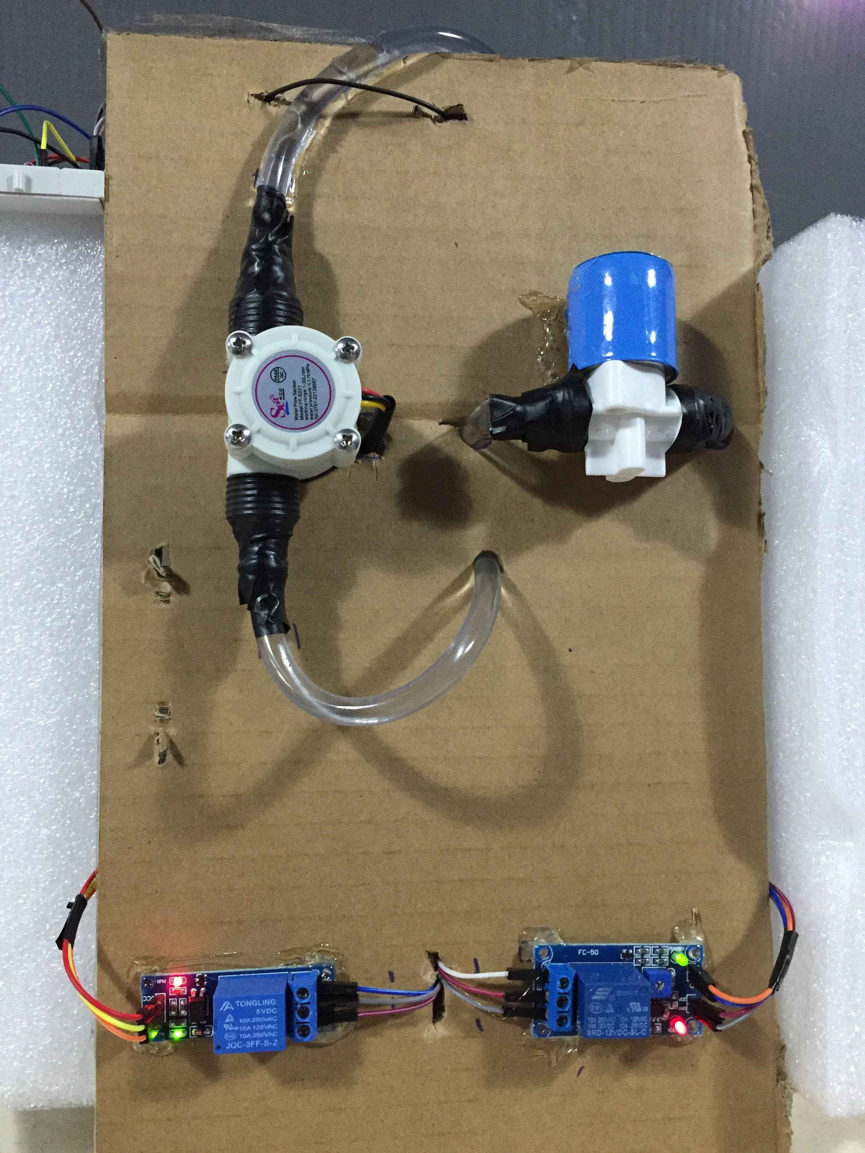
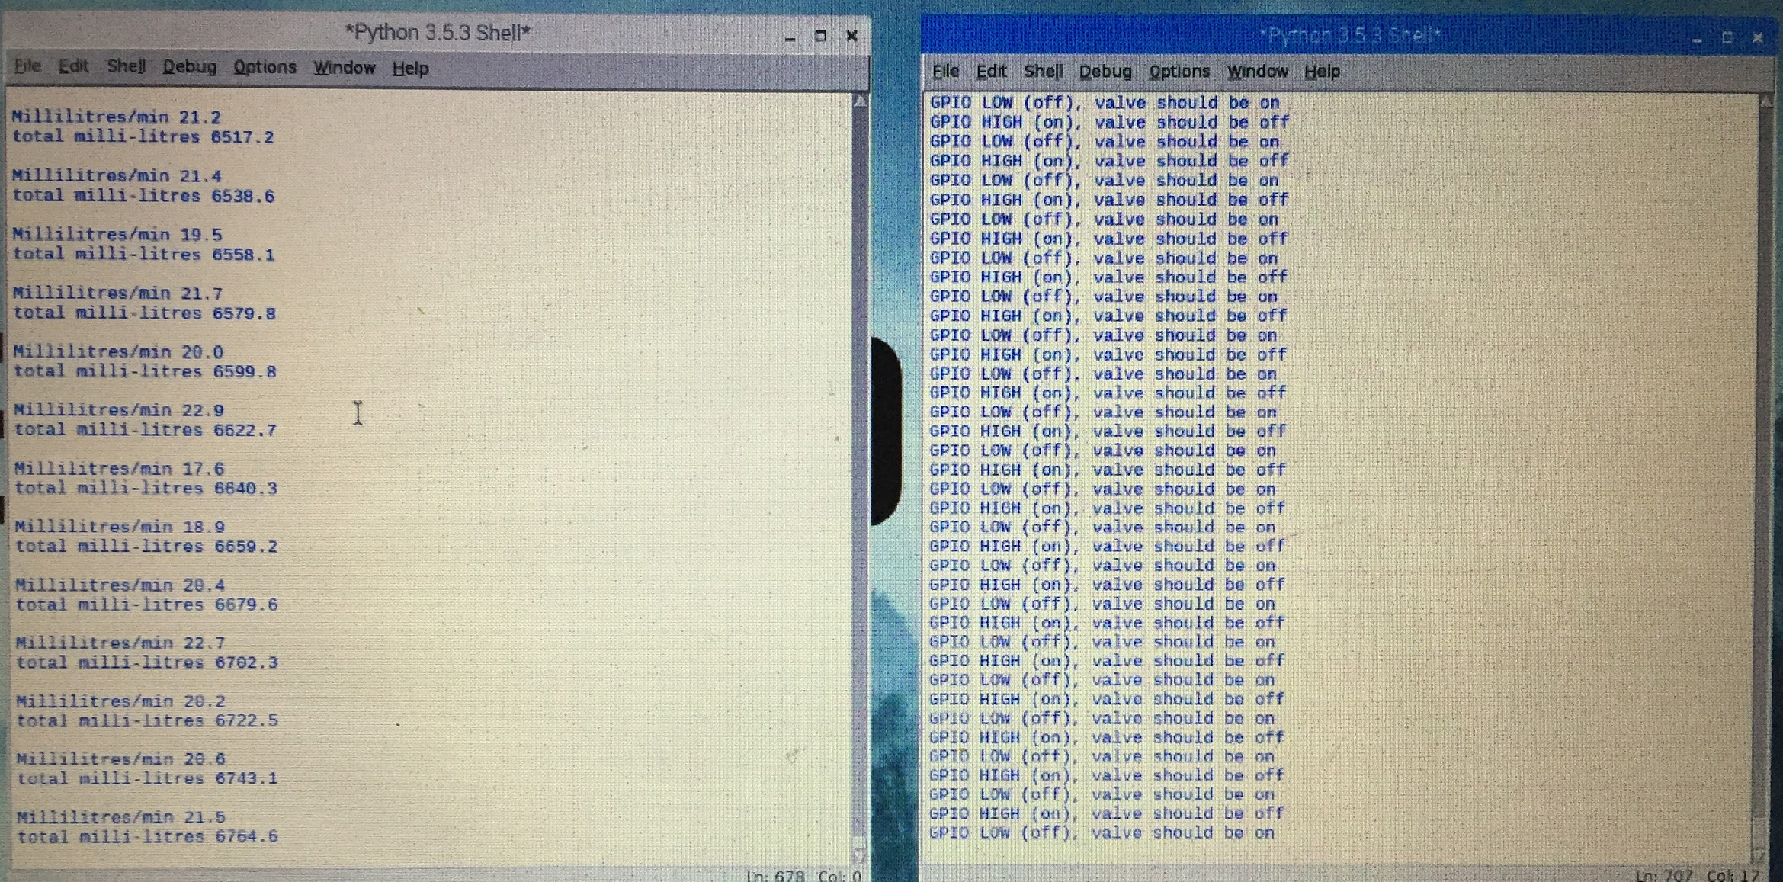

Slide 14
The Business Plan

Slide 15
Target Users
Government Water Boards
Industries
Oil Refineries
Large scale Plants
Large Residential Communities
Education Institutions

Slide 16
Cost cutoffs
Manufacturing cost:
Rs .2000 per unit
Other Expenses (Logistics, Marketing, R&D, Service):
Rs. 500 per unit
Total Cost:
Rs. 2500 per unit

Slide 17
Thank You
CodeWalkers - KGiSL
Sudharsan Rajendran
Aishvarya Mohan
Dharsan Kumar

